Slide 1

Profit Analysis of Global Superstores
By Sawari Jamgaonkar

Slide 2

PROBLEM STATEMENT
Global superstores are facing growing challenges to their profitability due to changing consumer preferences, increasing operational costs, and fierce competition. This analysis aims to pinpoint the key factors influencing profits across different product categories and regions. By analyzing sales data, customer demographics, and market trends, we seek to reveal insights that will help superstores optimize their inventory, improve customer targeting, and develop effective pricing strategies. The main objective is to present practical recommendations that can boost overall profitability and maintain a competitive edge in the global market.

Slide 3
PROJECT DESCRIPTION
This project aims to evaluate the sales performance of international superstores to pinpoint important factors that influence profitability across different product categories and regions. By using data visualization tools, we will develop an interactive dashboard showcasing vital metrics such as total sales, profit margins, and customer demographics. The analysis will incorporate visual elements like doughnut charts and trend graphs to reveal patterns and areas for enhancement. The ultimate goal of the project is to deliver practical insights that improve inventory management, marketing strategies, and overall profitability in a competitive market environment.

Slide 4
Project Cycle
Importing data set
Understanding the dataset
Data pre-processing, or cleaning
Visualization and generating dashboards

Slide 5

WHO ARE THE END USERS?
Store Managers: Responsible for daily operations, they need insights to optimize inventory and improve sales strategies.
Marketing Teams: They require data on customer demographics and preferences to design targeted marketing campaigns.
Finance Analysts: Focused on profit margins and financial performance, they use the analysis to assess overall profitability and budget allocation.
Supply Chain Managers: They need insights into product performance and sales trends to enhance inventory management and logistics.
Executive Leadership: Senior management relies on comprehensive data to make strategic decisions and set long-term business goals.
Data Analysts: They utilize the findings to conduct further analysis and generate reports that inform various business functions.

Slide 6
TECHNOLOGY USED
Power BI Desktop

Slide 7
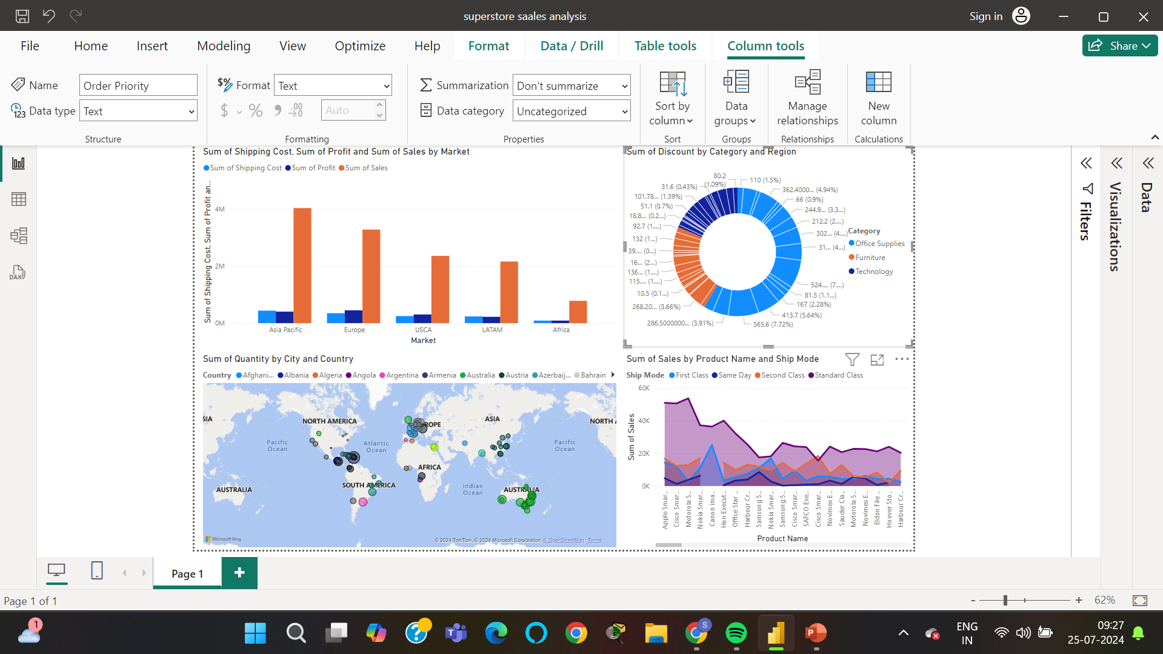
RESULTS

Slide 8
THANK YOU
.
.

